Slide 1
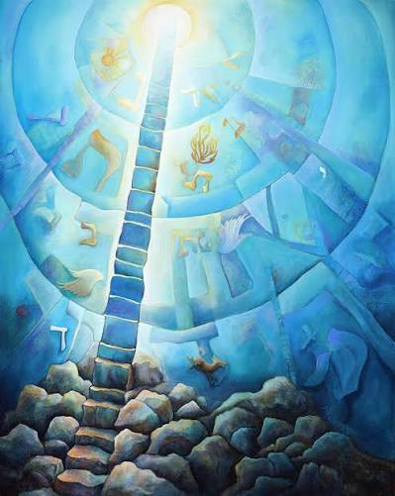
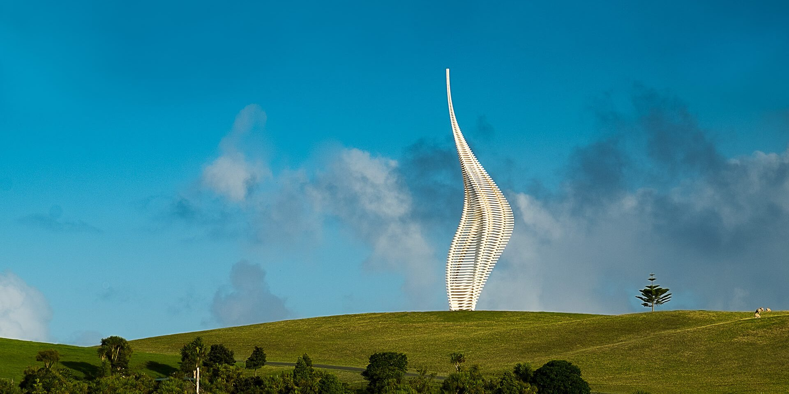
Jacob’s Ladder; Your Ladder
A Visual Exploration
Sarah Gallop
July 19, 2026
Gibbs Sculpture Park, New Zealand
Lesley Friedmann

Slide 2
Old Testament
Genesis 28:11-13
Taking one of the stones of the place, Jacob put it under his head and lay down in that place. And he dreamed that there was a ladder set up on the earth, the top of it reaching to heaven; and the angels of God were ascending and descending on it. And the Lord stood beside him and said, “I am the Lord”.
New Testament
John 1:51
And Jesus said to him, ”Very truly, I tell you, you will see heaven opened and the angels of God ascending and descending upon the Son of Man.”
John 14:6
Jesus said to him, “I am the way and the truth and the life. No one comes to the Father except through me.”

Slide 3
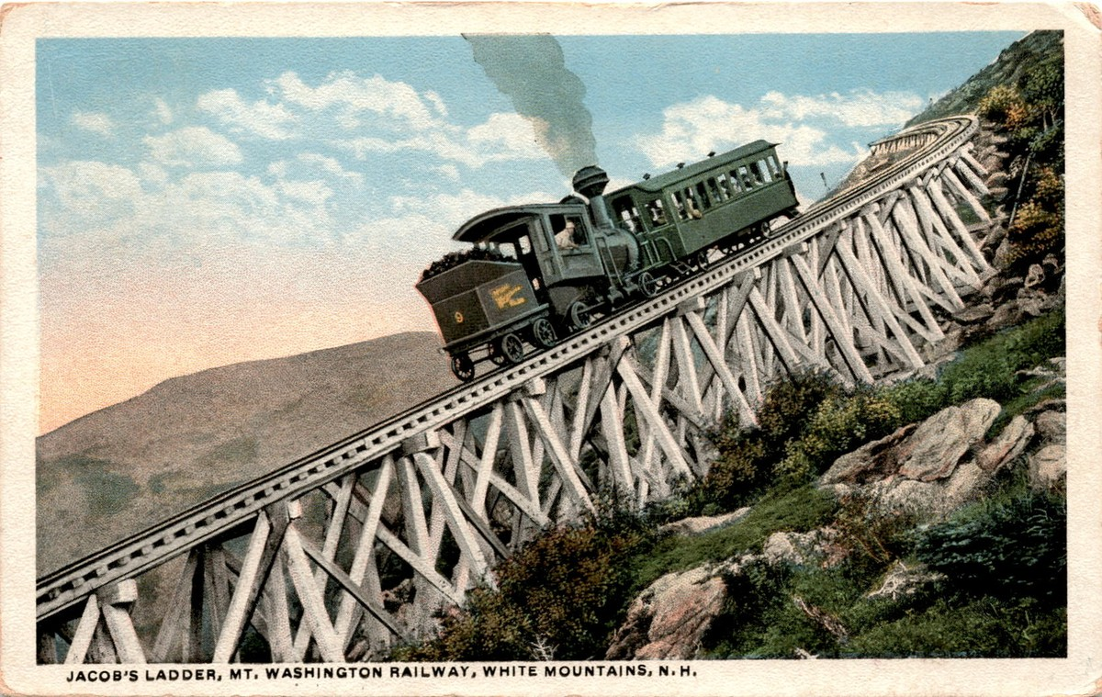
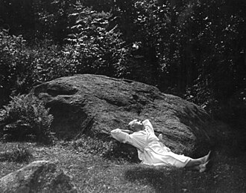
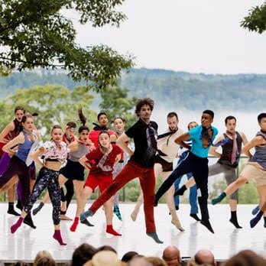
Jacob’s Pillow
Becket, MA
A stop on the Underground Railroad in the 1800s, now a National Historic Landmark, home to America’s longest-running international dance festival
Jacob’s Ladder
Cog Railway, Mt. Washington
The steepest railroad trestle in the world at a 37.41% grade

Slide 4
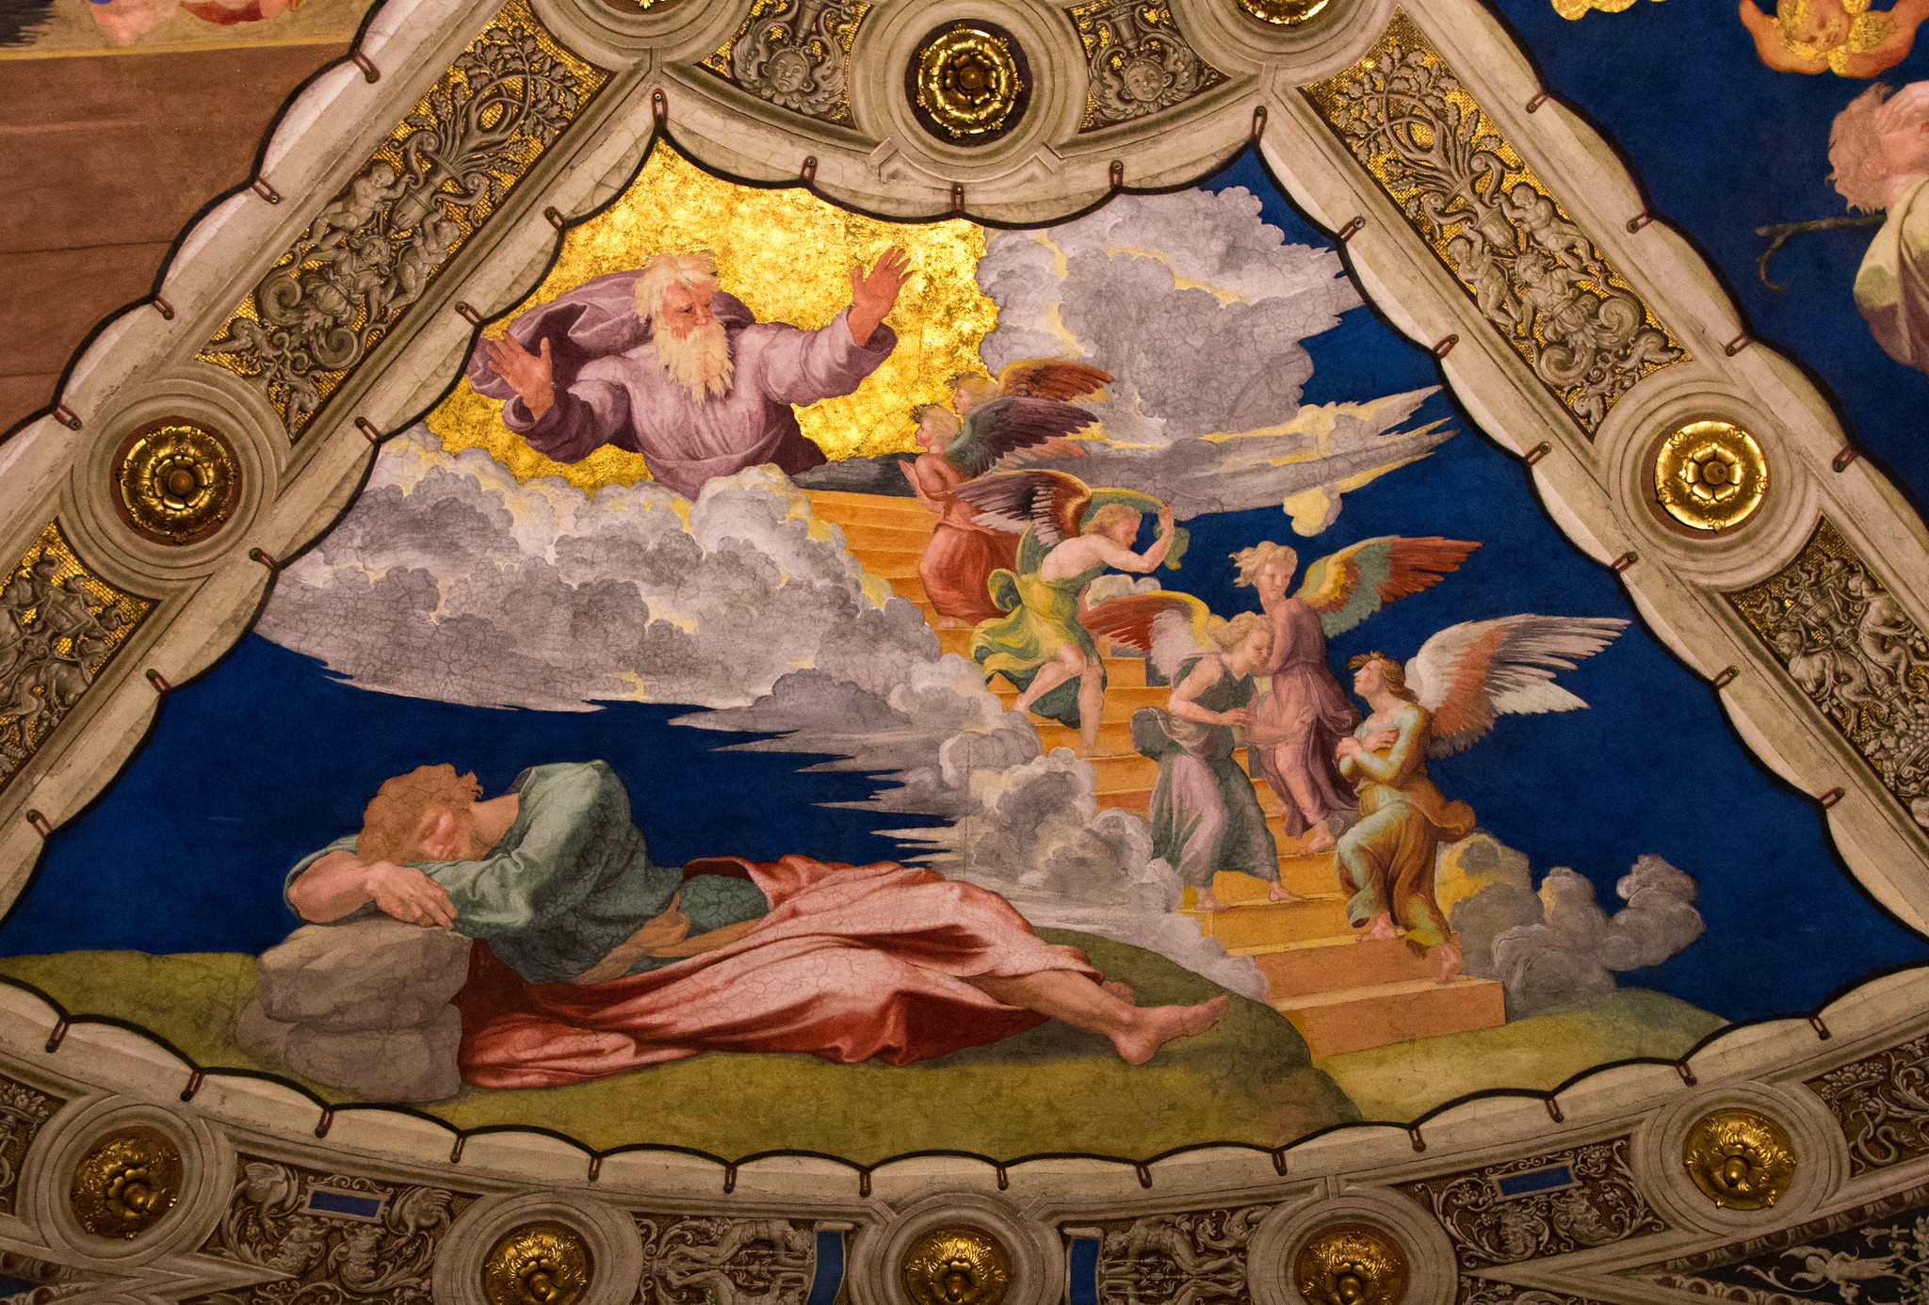
Raphael
“Jacob’s Dream at Bethel”
1518
Apostolic Palace, Vatican
Italian High Renaissance Classicism style, angels up and down grand stairs, God in gold light

Slide 5
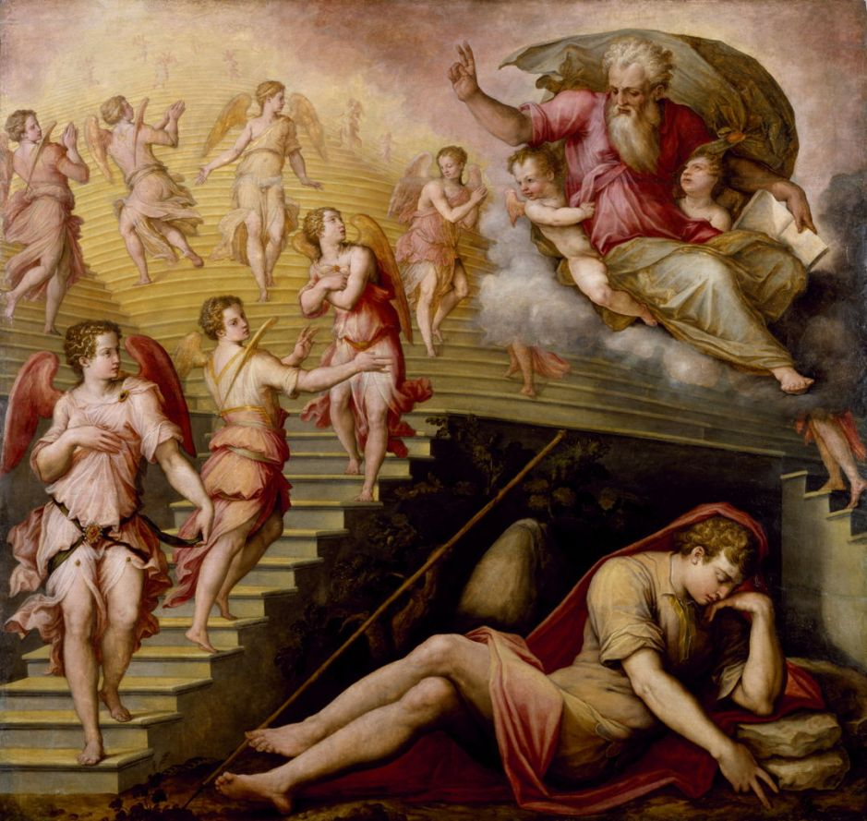
Giorgio Vasari
“Jacob’s Dream”
1558
Walters Art Museum, Baltimore
Italian High Renaissance Mannerism style, angels going up and down a double staircase, God on a cloud holding children

Slide 6
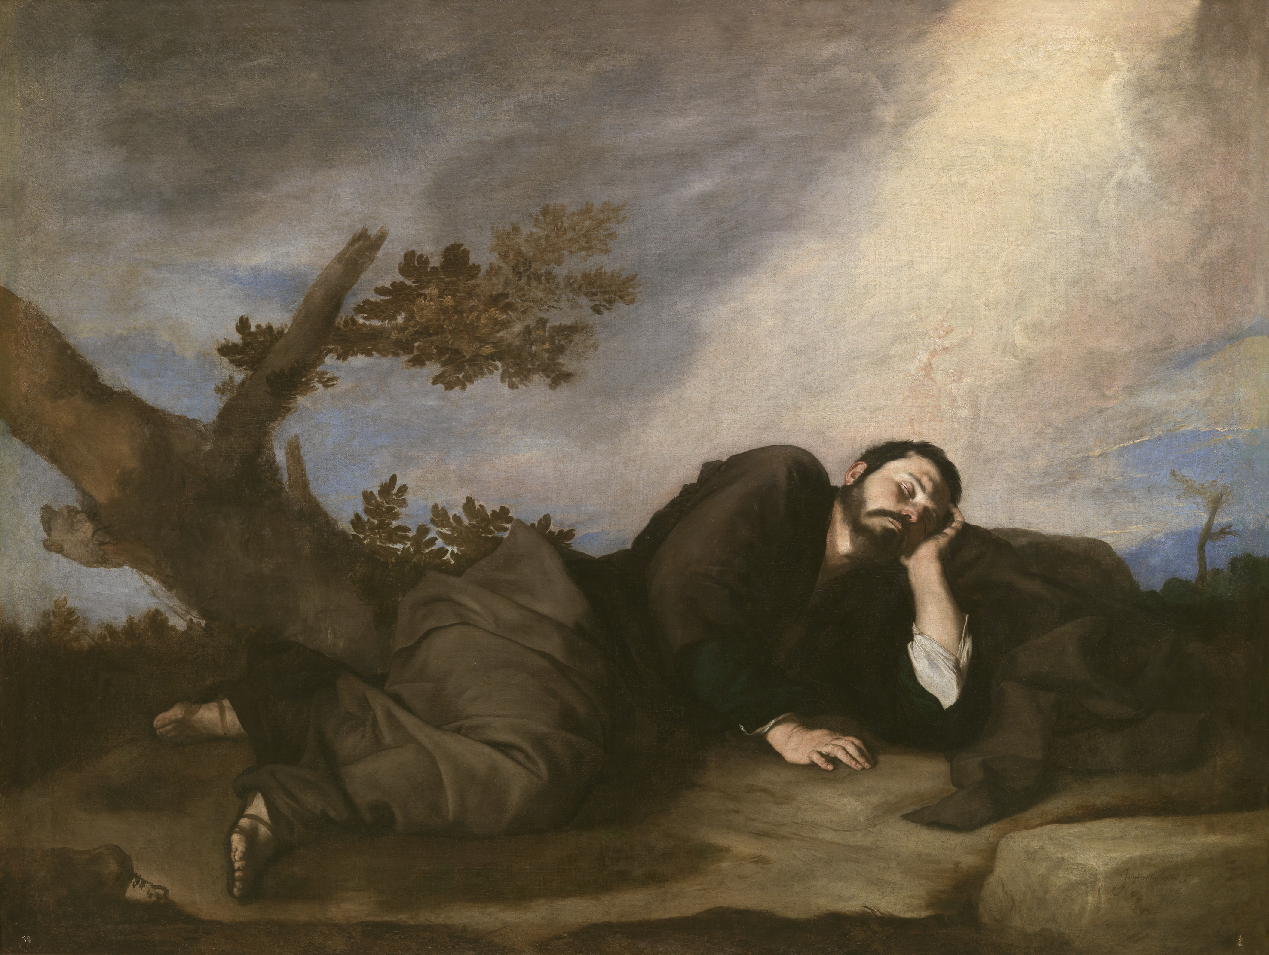
Jose de Ribera
“Jacob’s Dream”
1639
Museo del Prado
Madrid
Spanish Baroque Naturalism style, no angels or ladder, a raw, human depiction with subtle light as the ladder - just a hint of divine presence

Slide 7
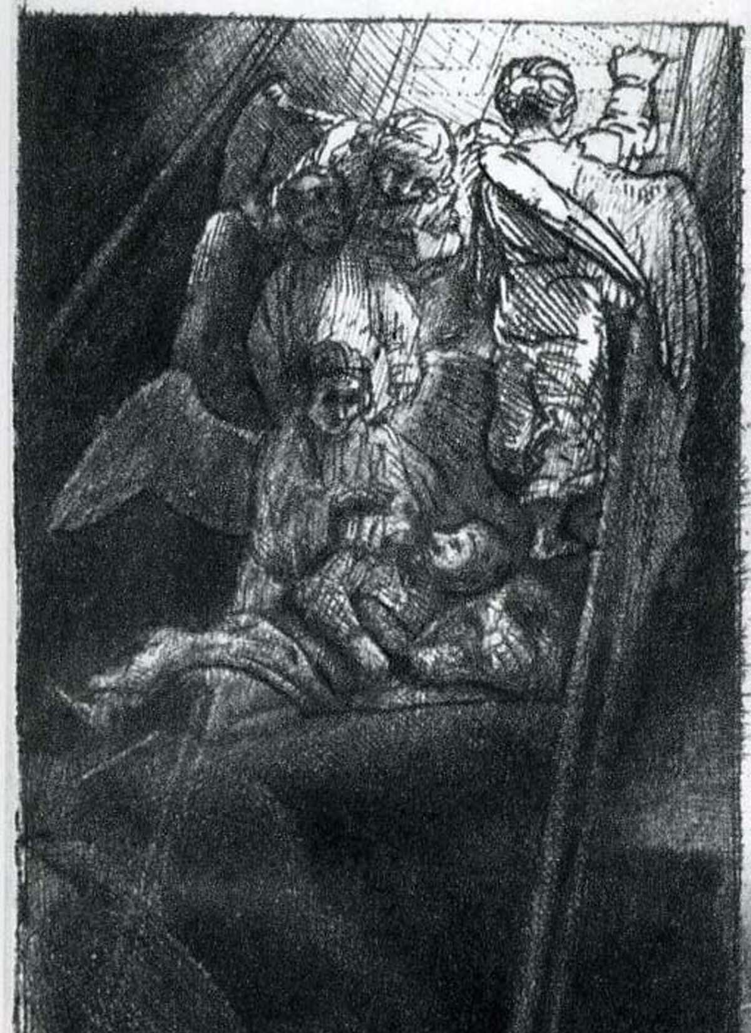
Rembrandt
“Jacob’s Ladder”
1655
Metropolitan Museum of Art NYC
Dutch Golden Age ink style, miniature etching with angels on a narrow ladder, atmospheric depiction of darkness at the bottom, light at the top

Slide 8
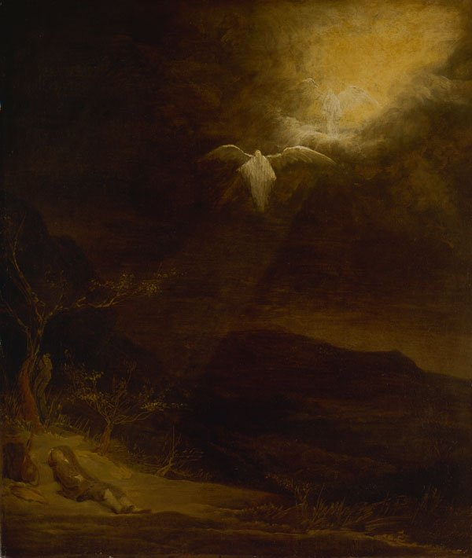
Arent de Gelder
Jacob’s Dream
1720
Dulwitch Picture Gallery London
Late Rembrandt Expressive style, no physical ladder, two angels hovering in a beam of divine light breaking through the dark sky

Slide 9
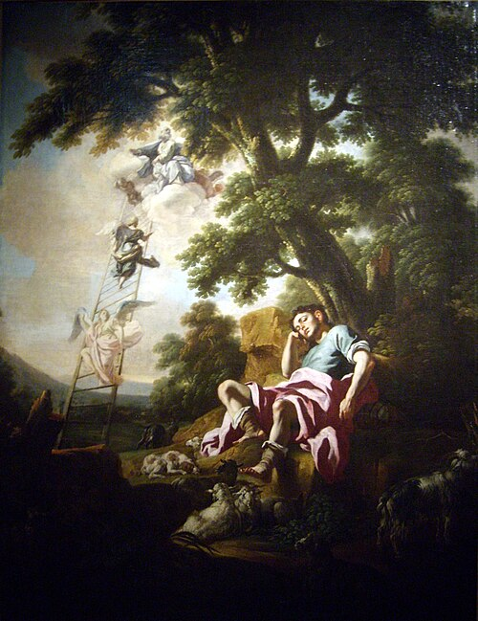
Francesco Solimena
“Jacob’s Ladder”
1730
Musée Thomas-Henry
Cherbourg, France
Italian Baroque Chiraoscuro style (light and dark contrasts), a glowing path of light in the clouds, bright angels fill the sky as they travel up and down the staircase

Slide 10
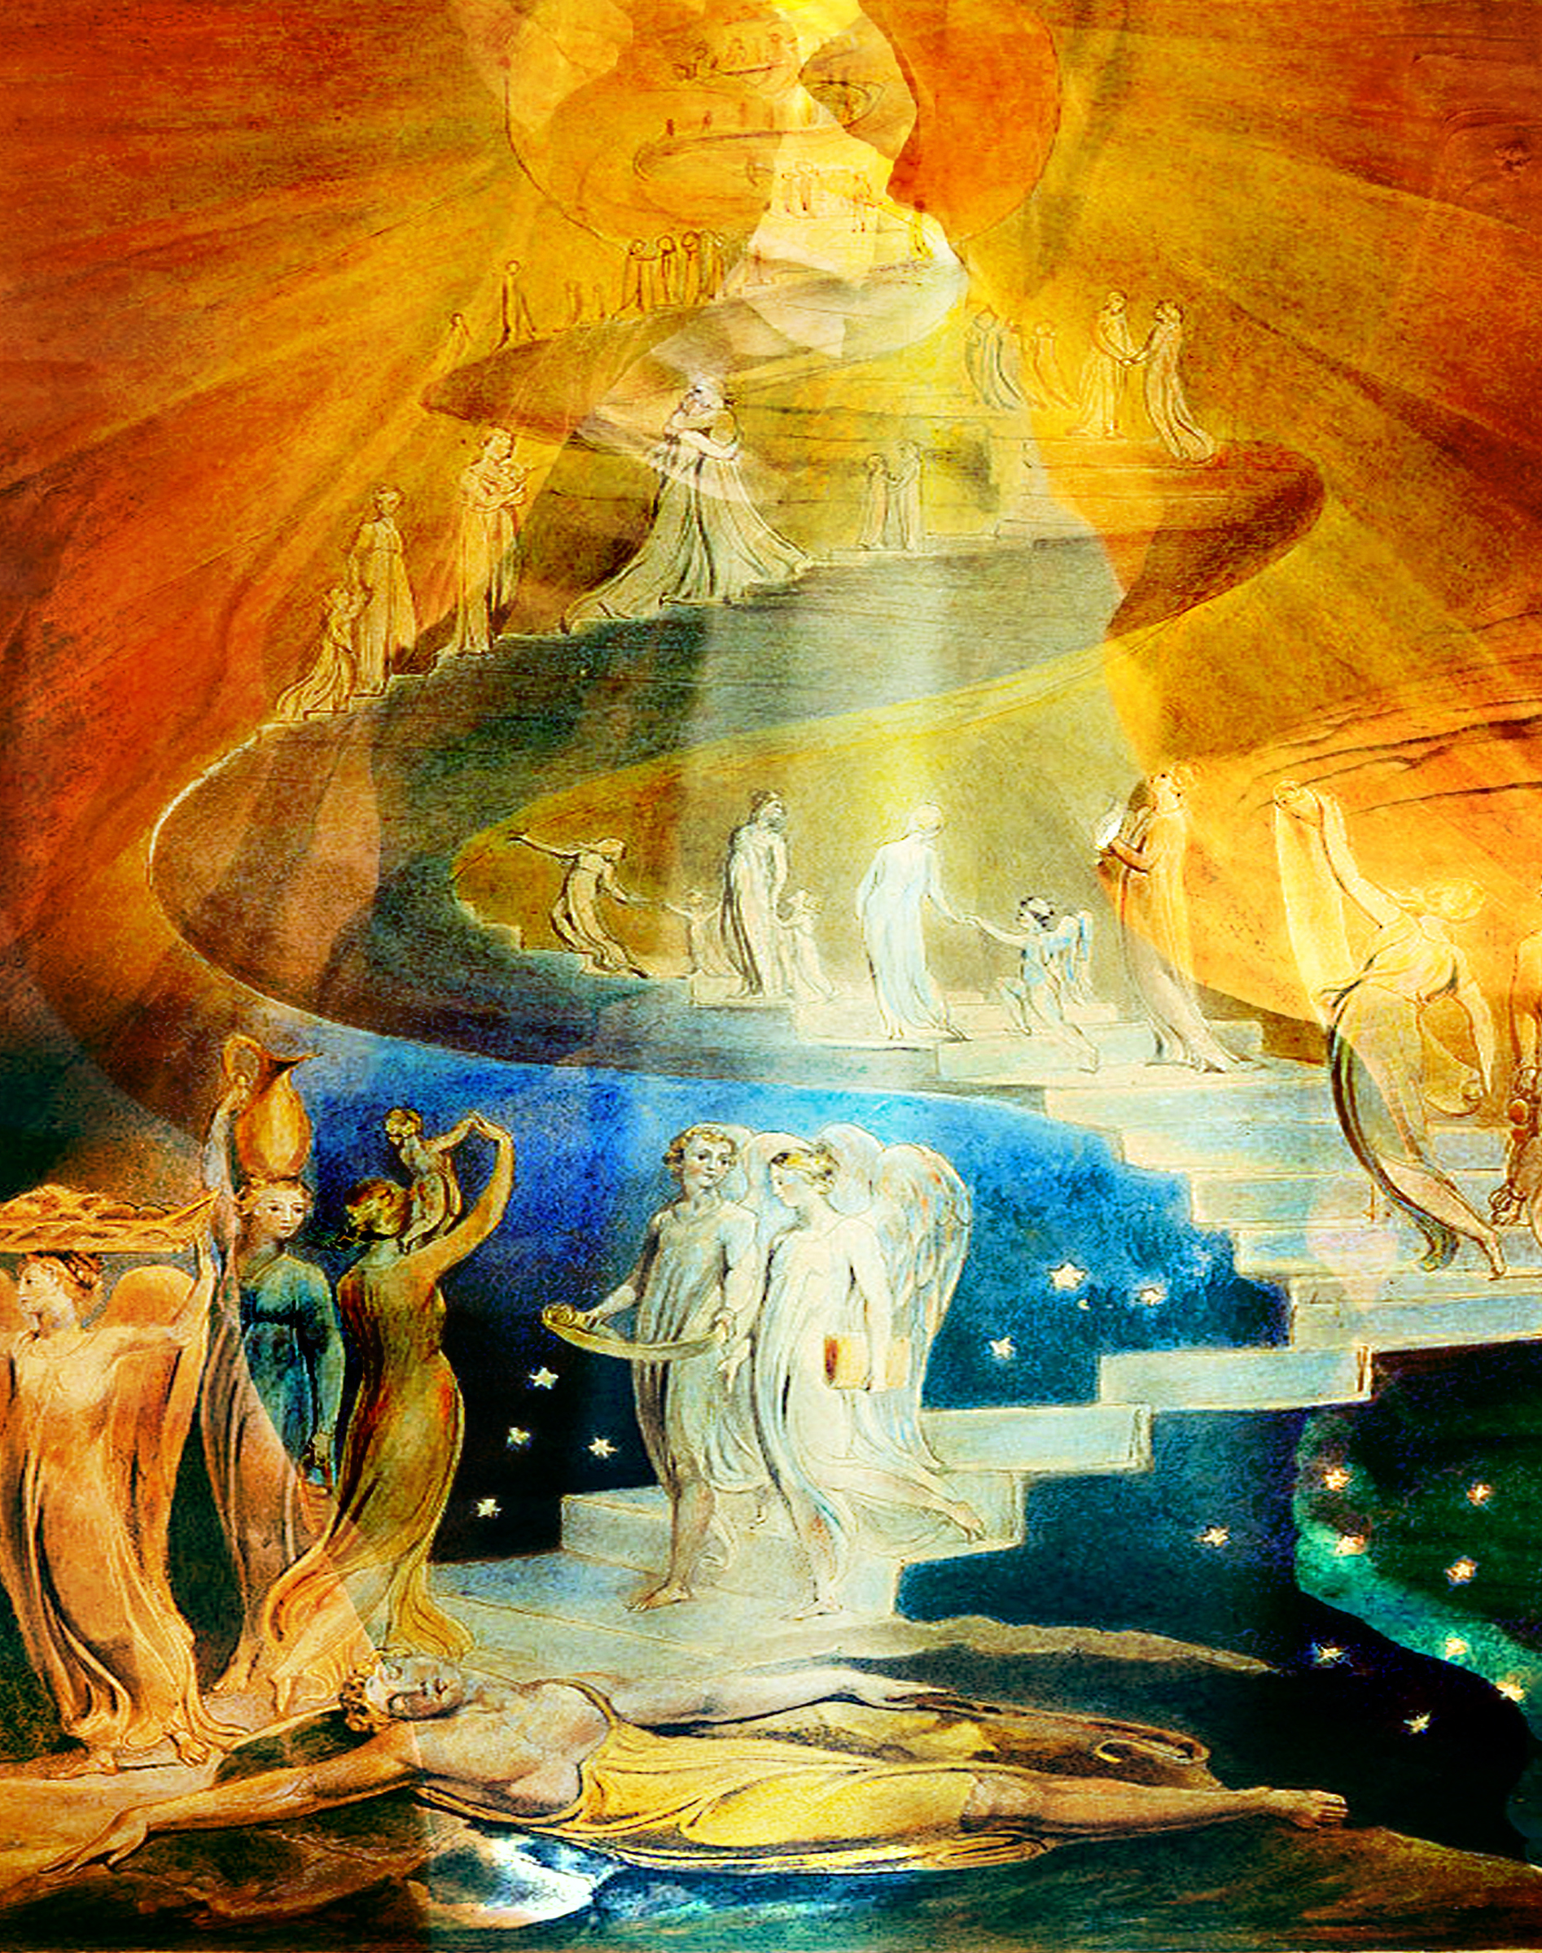
William Blake
“Jacob’s Ladder”
1805
The British Museum
London
Visionary Symbolist style, vivid watercolor, sweeping and vast spiral staircase with no structural integrity, angels going up and down in dream-like light

Slide 11
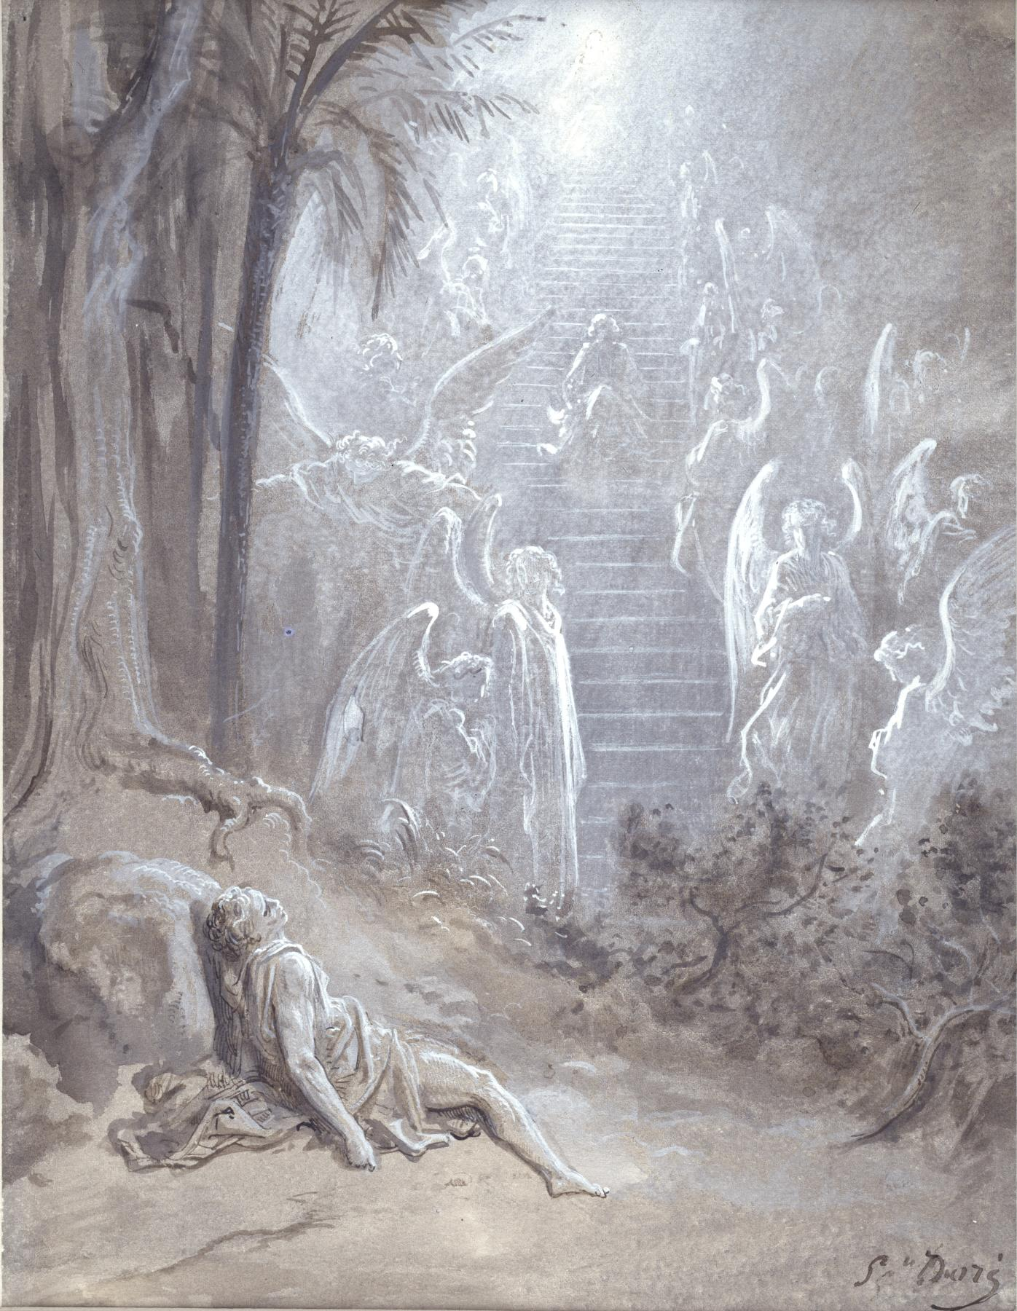
Gustave Dore
“Jacob’s Dream”
1865
Walters Museum
Baltimore
Dramatic Chiraoscuro style (light and dark contrasts), pen and ink, radiant angels on a long stairway, divine light at top conveying spiritual majesty

Slide 12
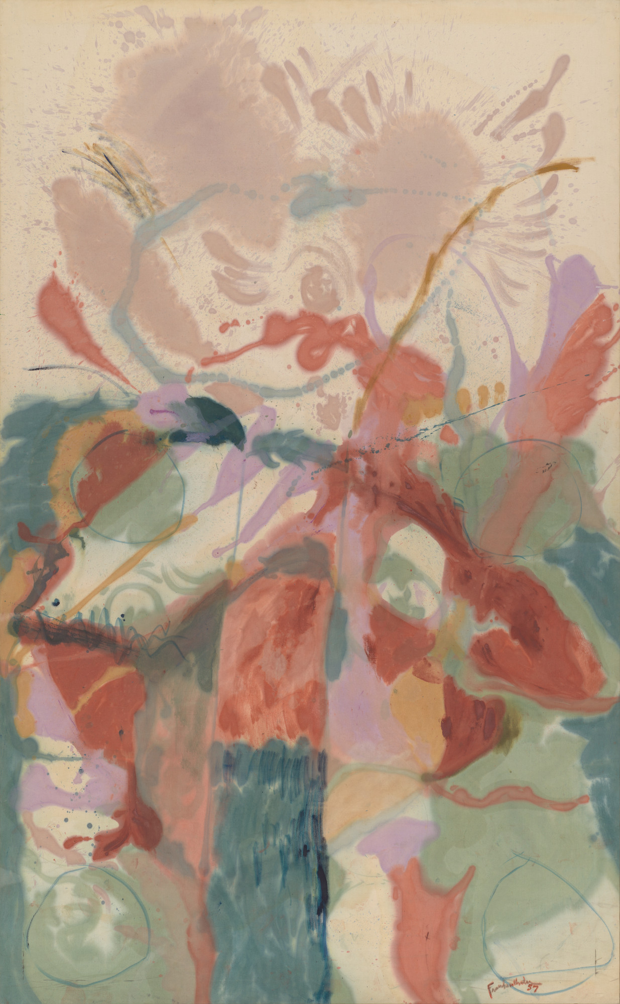
Helen Frankenthaler
“Jacob’s Ladder”
1957
Museum of Modern Art
NYC
Abstract interpretation, oil paint soaked into canvas, no clear ladder or angels

Slide 13
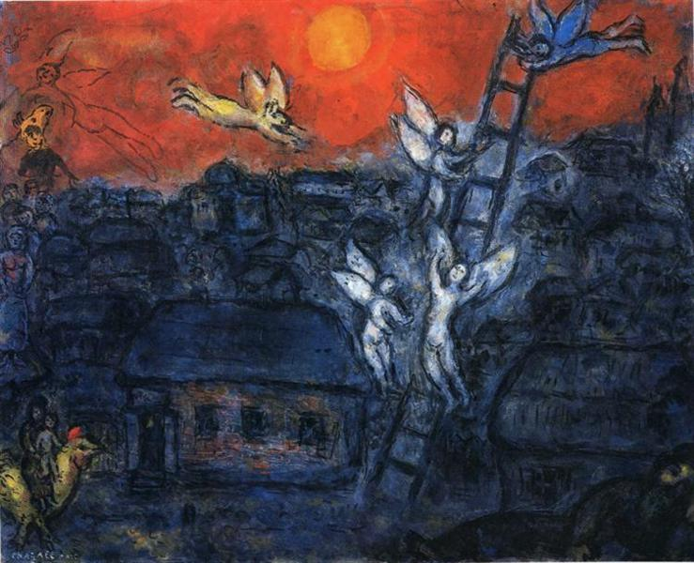
Marc Chagall
“Jacob’s Ladder”
1973
Private Collection
Avant Garde style in a dark urban setting with a narrow ladder, Jacob is being lifted up by an angel

Slide 14
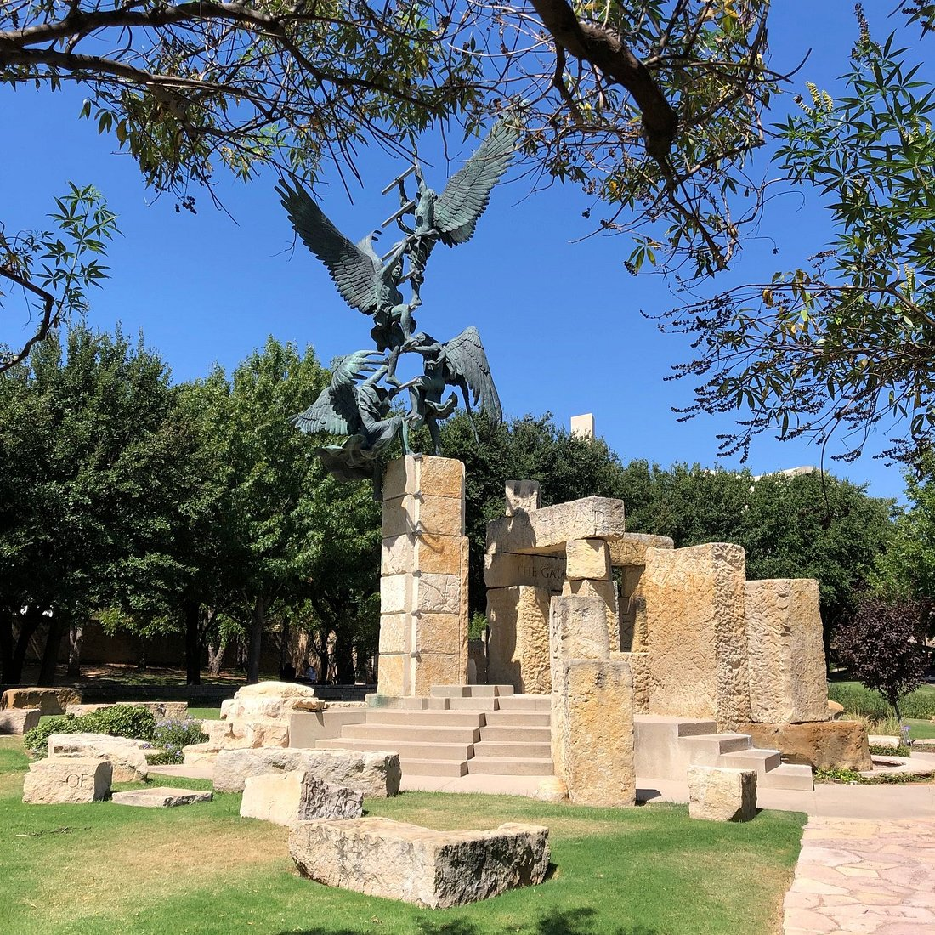
Jack Maxwell
“Jacob’s Dream”
2006
Abilene Christian University
Texas
Bronze Sculpture, four 8-foot-tall angels ascending and descending a ladder reaching to heaven, surrounded by limestone “ruins” inscribed with the scripture from Genesis and John, and a baptismal pool with a stone fountain

Slide 15
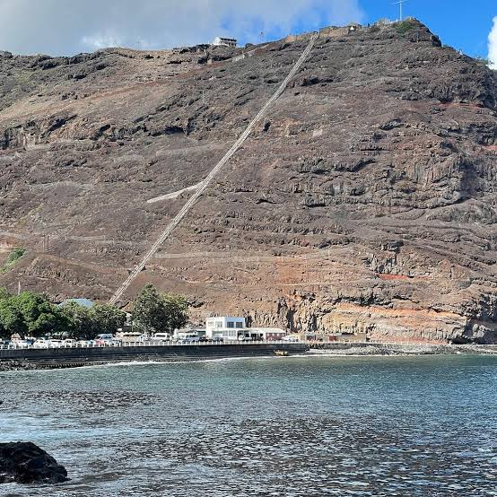
Jacob’s Ladder
Jamestown, St Helena
Built in 1829 on this remote volcanic island, one of the longest and steepest staircases in the world, 699 steps on a near-vertical rock face connecting two communities — where Napoleon was exiled and died!

Slide 16
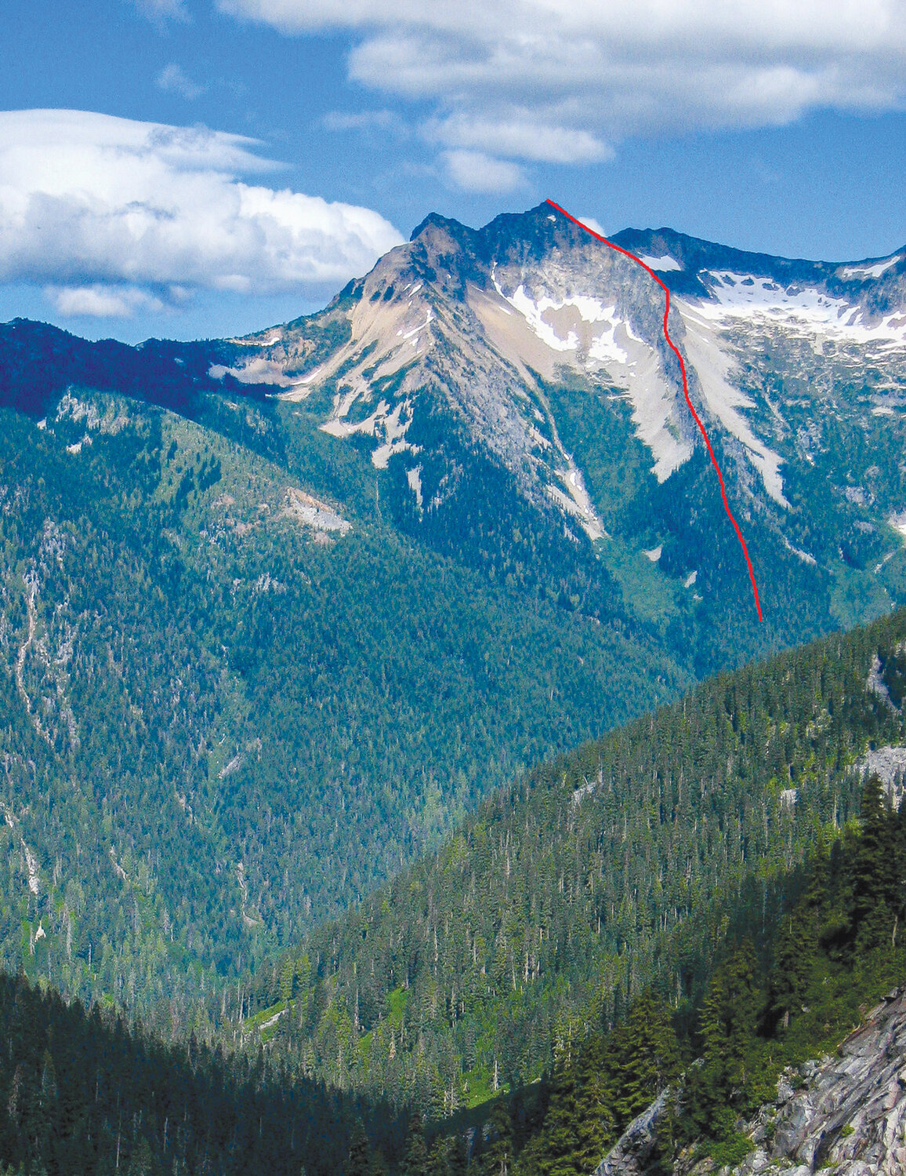
Jacob’s Ladder
Mt. Prophet
North Cascades National Park
Washington State
A knife edge ascent up a narrow rib of rock up to the remote summit of Mt. Prophet at 7,640 feet. “Because of its steep location, climbers rarely visit”

Slide 17
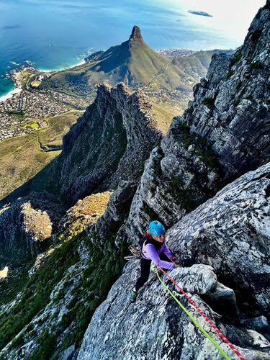
Jacob’s Ladder
Table Mountain
Cape Town, South Africa
A legendary, world-class rock-climbing route renowned for its incredible exposure and stunning Atlantic views. Accessing the climb requires navigating the mountain's steep, rugged terrain

Slide 18
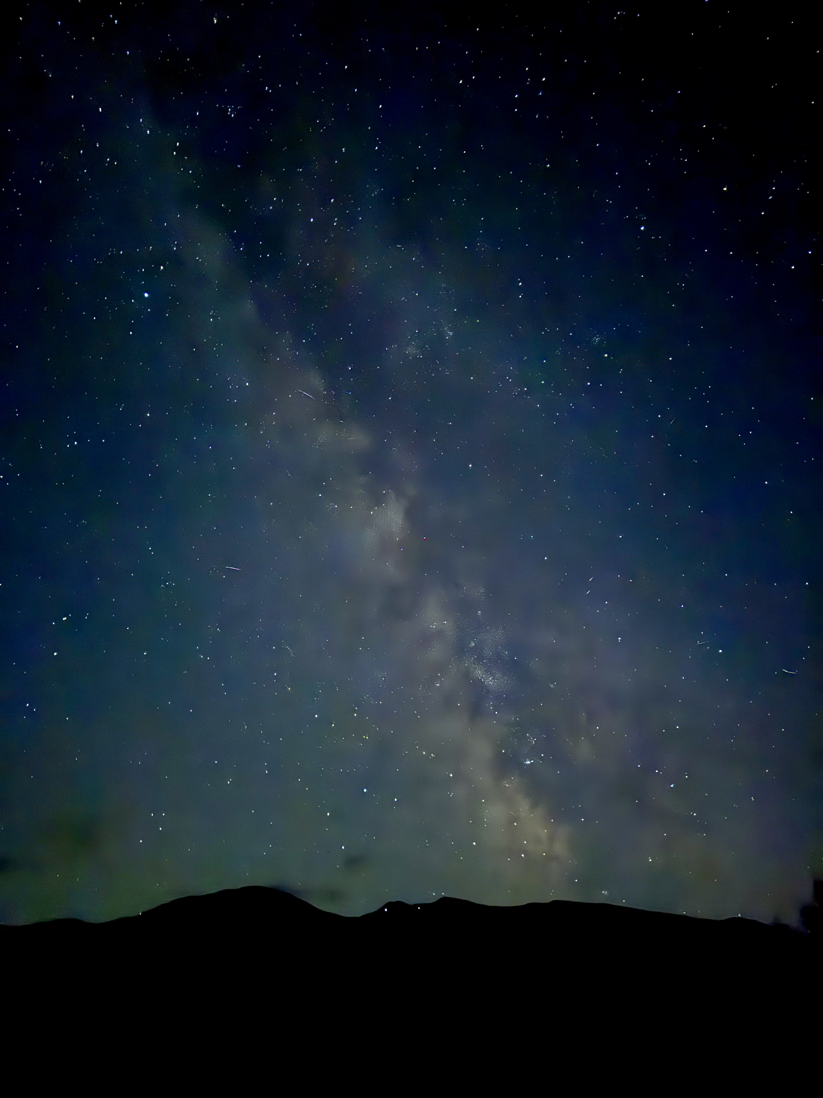
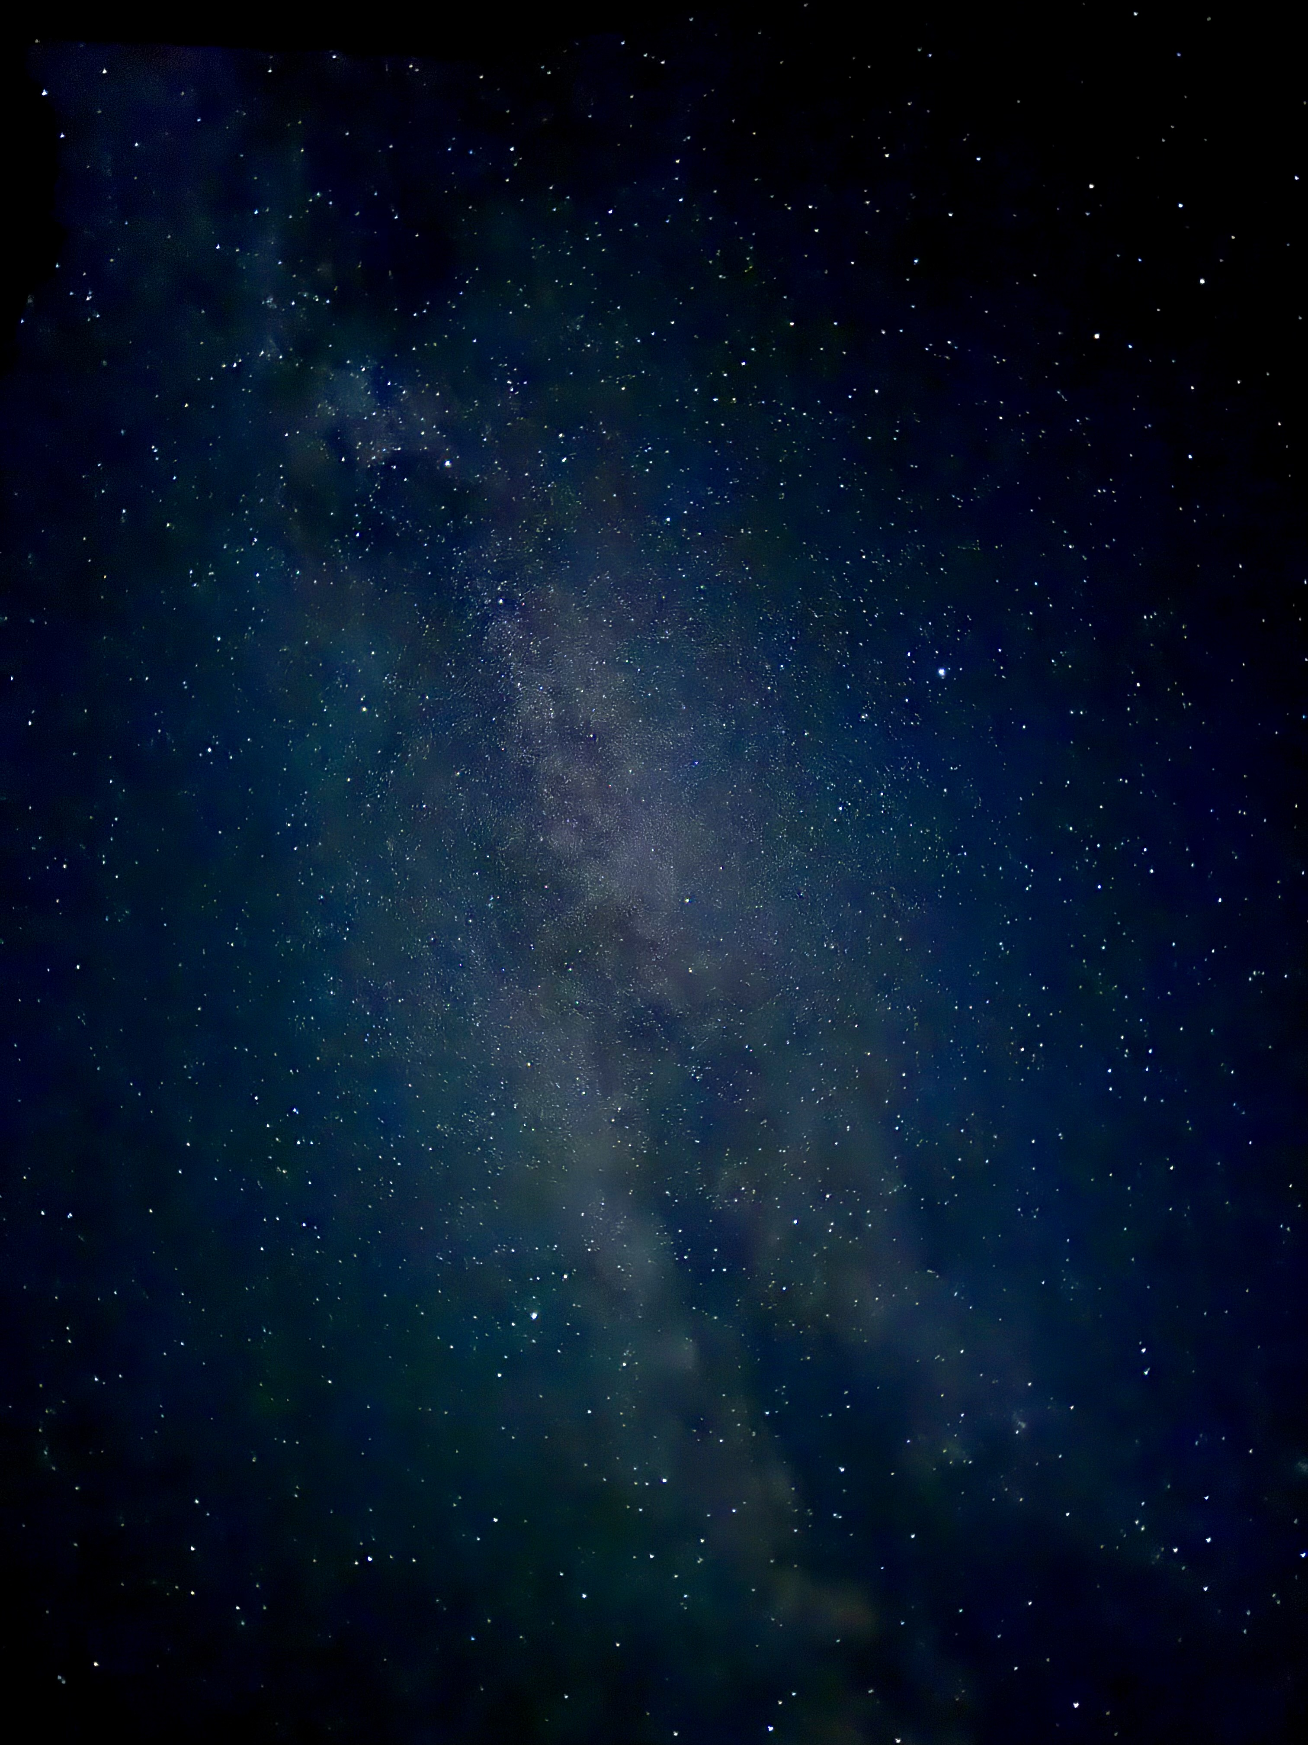
I like the idea of the Milky Way
being my ladder.
So infinite and strong!

